Slide 1

Travel Pack
Ediomo Samuel
Brazil
17-21 September 2024

Slide 2

Table of Content
Introduction
Entry/Exit Requirement
Etiquettes/Culture
Event Information
Confirmed Meeting
TABLE OF CONTENT

Slide 3
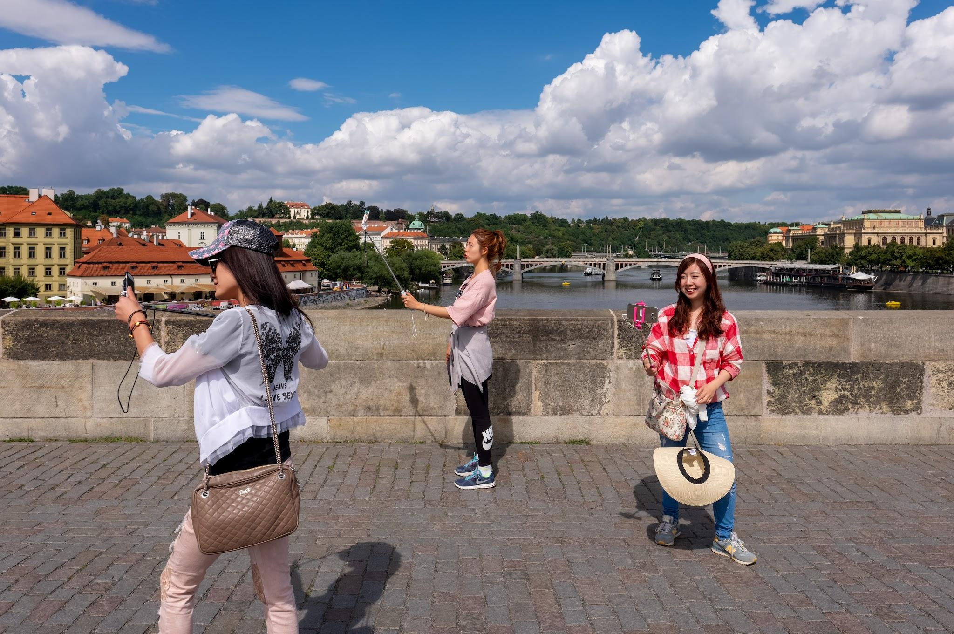
Introduction
EEEdiomo Samuel
Rio de Janeiro Brazil
17th-21st September 2024
Introduction

Slide 4
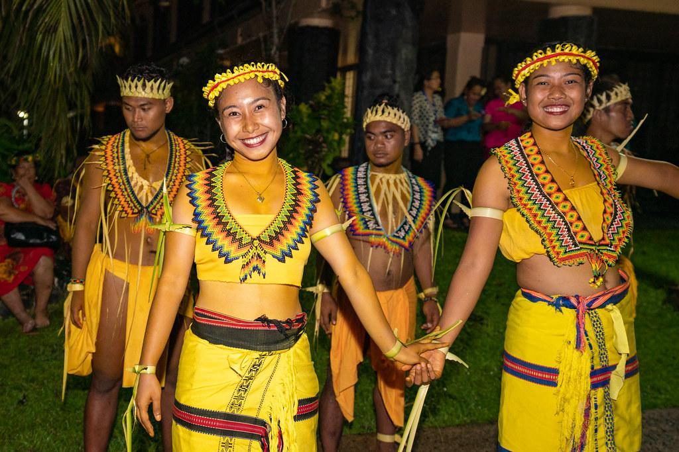
Greetings :Dos -When meeting someone for the first time, a firm handshake,hug or kiss on the cheek. Don’ts - Avoid standing too far away or being overly reserved .
Communication : Dos -Learning a few basic phrases can go a long way in showing respect to the culture . Don’ts - Avoid making negative remarks about Brazil .
Dining and Visiting people : Dos - When invited to someone’s home it is important to bring a small gift along with you. Don;ts - Avoid starting to eat before the hostbegins or leaving the table immediately after finishing your meal.
Etiquette &
Culture

Slide 5
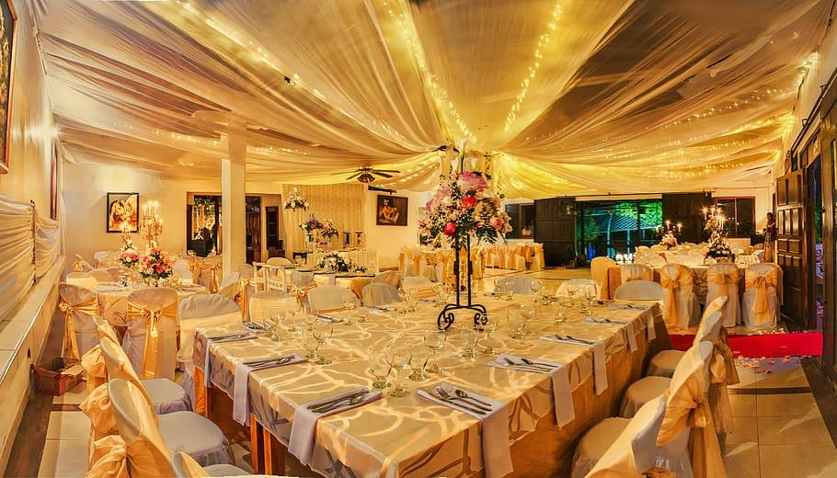
Ride on the historic Santa Tereasa tram up through the traditional neighbourhood.
Take a look at the Iconic Copacabana boardwalk.
A visit to the zoo
Night life is a must for me to enjoy.
Event Information

Slide 6
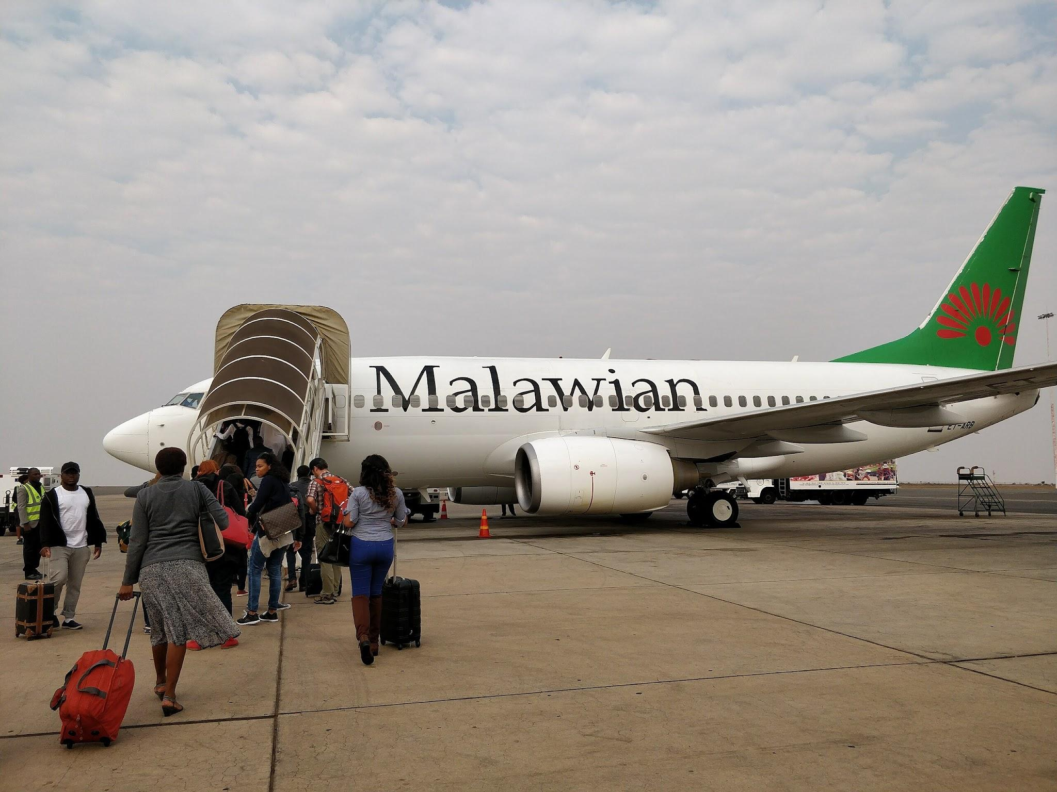
Passport Validity : Must be valid on the date of entry.
Blank Passport Pages:One page required for entry stamp.
Vaccination:Non required,but see health section.
Currency Restriction For Entry: More than 10,000 BR must be declared to custom.
Currency Requirement For Exit:More than 10,000 BR must be declared to custom.
https://travel.state.gov/content/travel/en/international-travel/International-Travel-Country-Information-Pages/Brazil.html
Entry &
Exit Requirement

